Slide 1
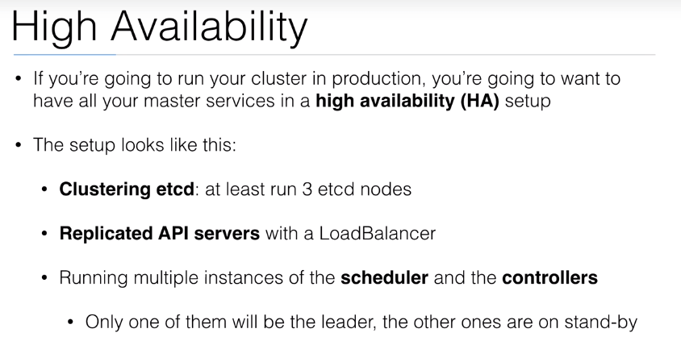

Slide 2
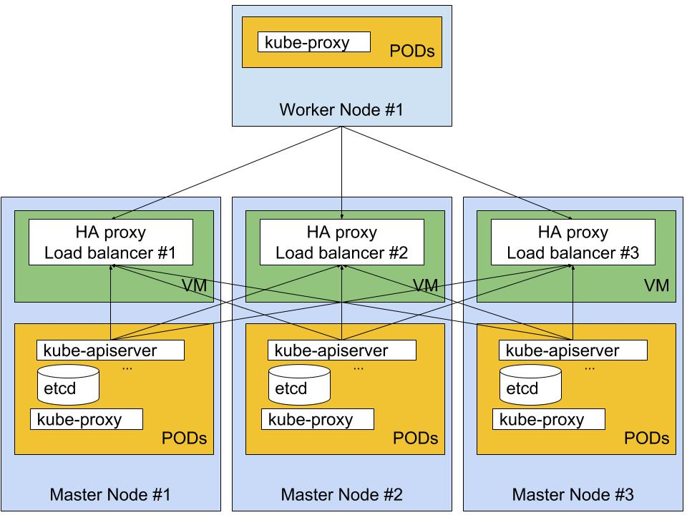

Slide 3
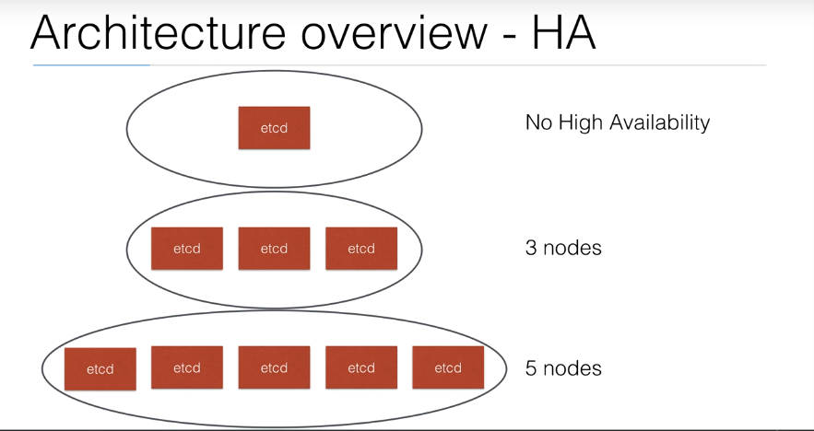

Slide 4
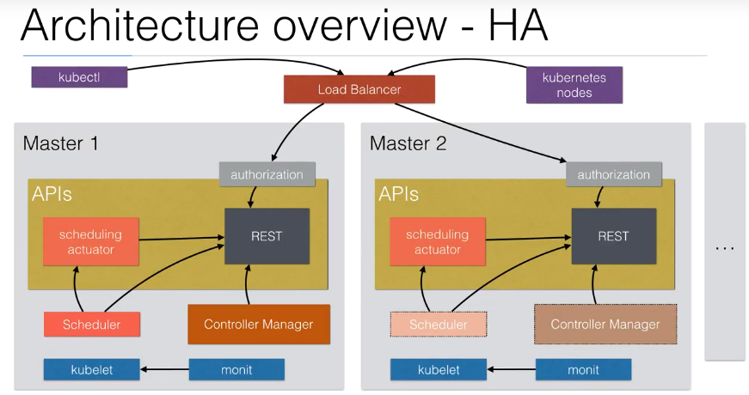

Slide 5
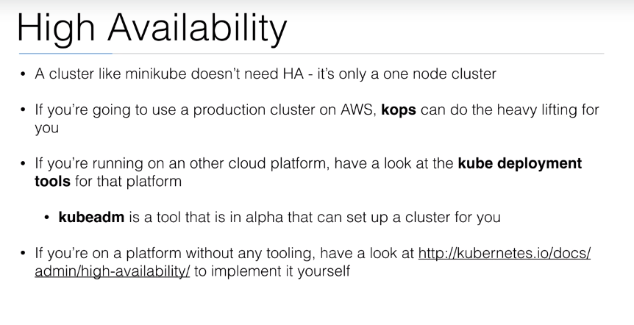

Slide 6
KubeSpray
KubeSpray is an incubated Kubernetes community project for deploying K8s clusters on premises or in the cloud
Deploy Anywhere
High Availability Support
Choice of Network Plugins
Kubespray enables you to choose from the following four network plugins:
flannel: gre/vxlan (layer 2) networking
calico: bgp (layer 3) networking
canal: a composition of calico and flannel plugins
weave: a lightweight container overlay network that doesn’t require an external K/V database cluster

Slide 7
Production-Ready, Multi-Master HA Kubernetes Cluster
Installation Procedure Kubespray with Ansible
https://github.com/MohanRamadoss/kubernetes/tree/master/LAB/kubespray

Slide 8


